Slide 1
Grassland indicator species
(KS4)

Slide 2
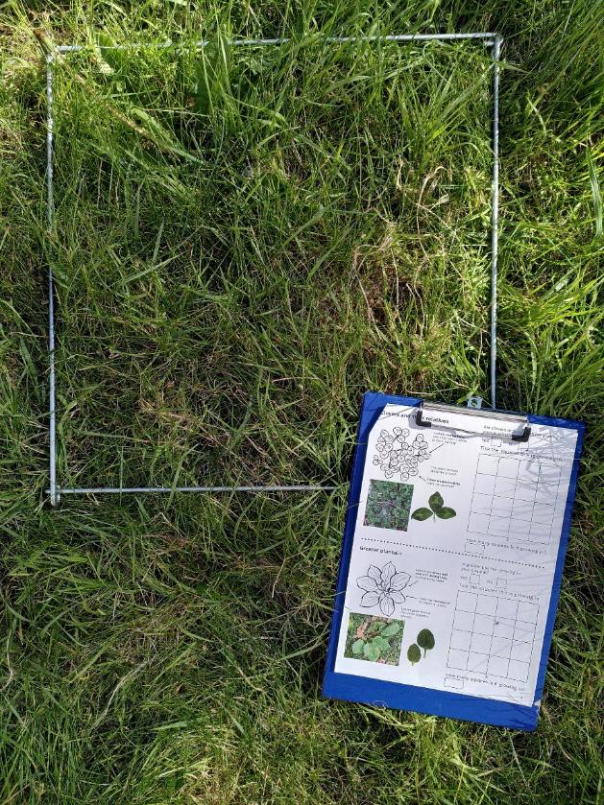
The Grassland Plant Survey
Note for teachers
This resource can be used to support your learners to take part in the Grassland Plant Survey. The survey is based on species lists used by the National Plant Monitoring Scheme to classify habitats in the UK.
While the plants in this survey cannot be used to exactly classify the habitat, the information can be used to infer the health of the grassland habitat and gives an indication of biodiversity in an area.
This information can help with wider decision-making about how space is used and how nature can be supported while still meeting the needs of people using the space.

Slide 3
Learning outcomes
understand that abiotic and biotic factors affect plant communities
understand that human activities have effects on soils, and that this affects the surrounding ecosystem
able to infer information about soil chemistry and structure by using the presence or absence of indicator species

Slide 4
Key vocabulary
Indicator species - an organism whose presence, absence, or population size tells us something about the environment or ecosystem
Generalist - organisms that can live and reproduce in a wide range of habitats
Tolerant – able to survive, grow, and reproduce under certain conditions
Nutrients - any substance that living things need to survive and grow. Nutrient concentrations have big impacts on an ecosystem
Notes:
See the Grassland indicator vocabulary presentation for more details and examples.

Slide 5
Key vocabulary
Disturbance - something that breaks up the soil surface
Trampling - stepping on something
Mowing - cutting grass shorter, usually with a machine
Compaction - squashing together soil particles. More compaction slows the rate at which air and water can move through the soil
Notes:
See the Grassland indicator vocabulary presentation for more details and examples.

Slide 6
Grassland Plant Survey indicator species

Slide 7
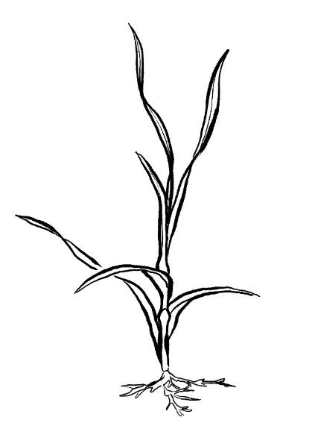
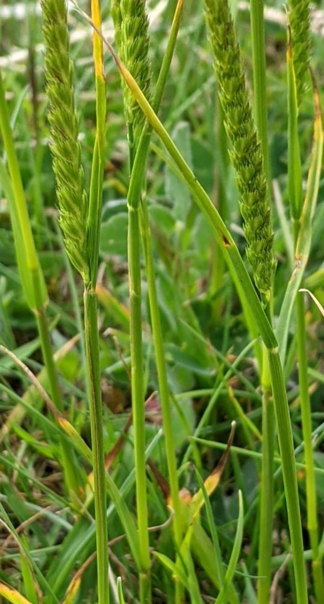
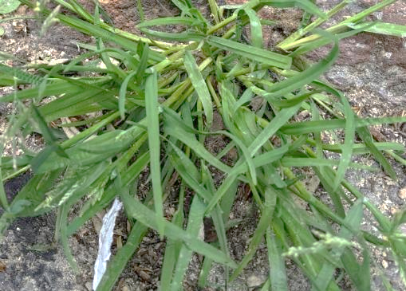
Grass
Around 220 wild species in the UK.
Usually very tolerant to mowing or grazing.
Some species are tolerant to a wide range of conditions.
Some species can be sensitive to very wet and shaded conditions.
Notes:
You could discuss for each indicator what features do they notice.
If you have given out the survey form already ask them to turn to part 2 and follow along with each plant in the survey form.

Slide 8
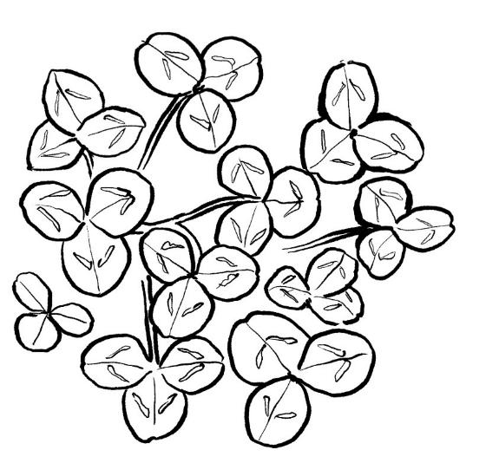
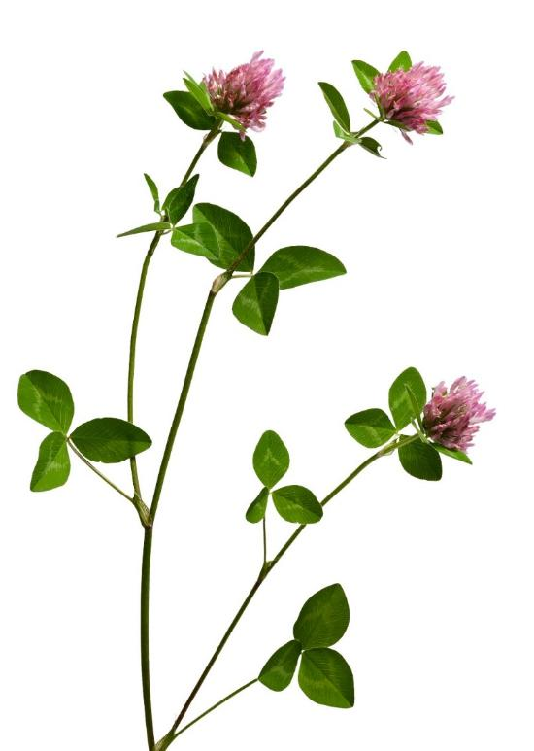
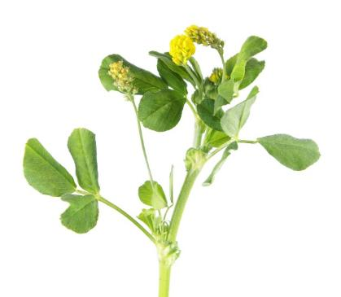
Clovers and their relatives
Tolerant of mowing and trampling.
Increases available nitrogen in the soil. Nodules on their roots host bacteria that convert nitrogen from air into forms the plants can use.

Slide 9
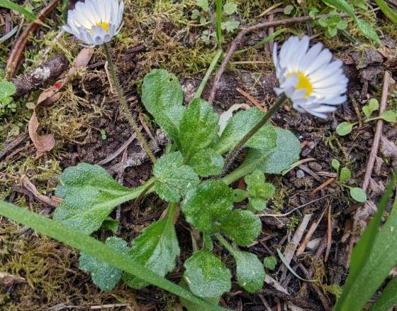

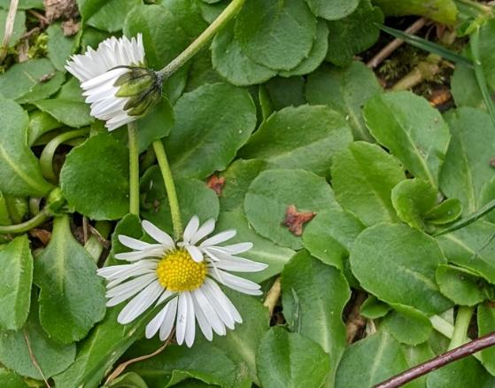
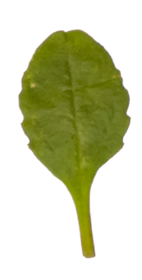
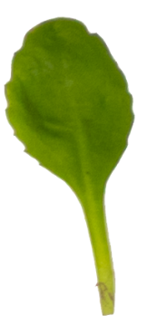
Common daisy
Tolerant of mowing and trampling.

Slide 10
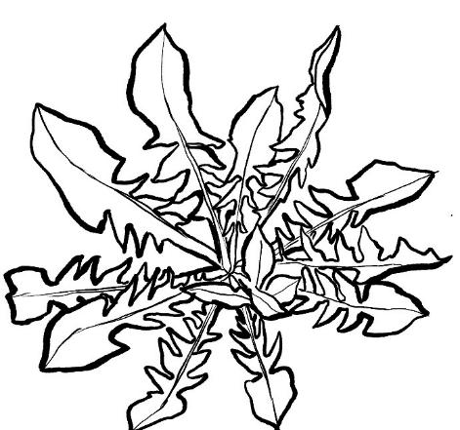
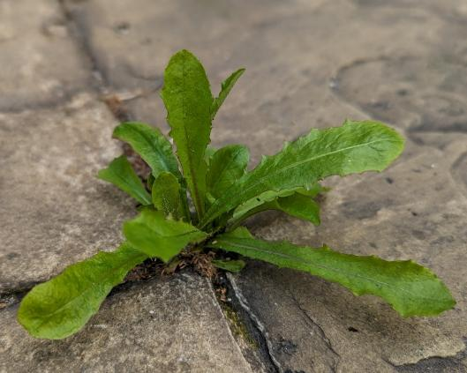
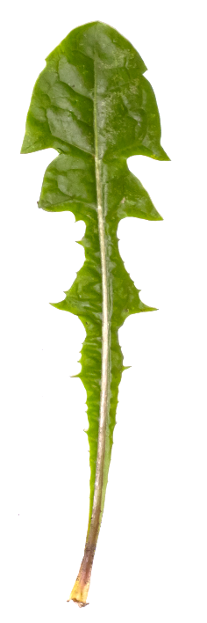
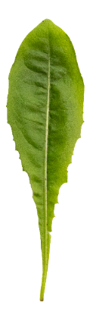
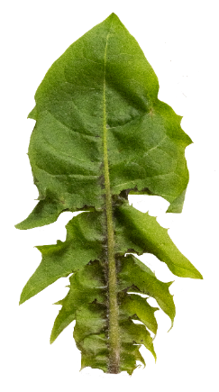
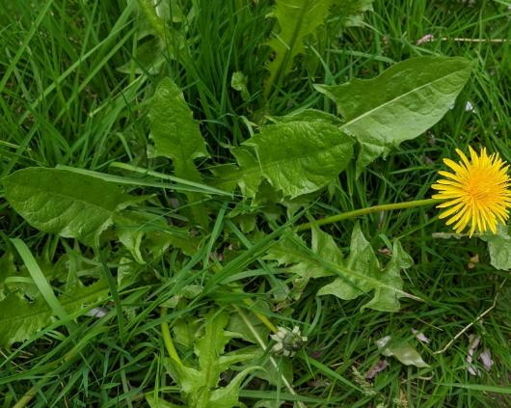
Dandelion
Thrives in high-nutrient environments and tolerant of trampling.
More than 200 closely related species in the UK.
Leaves from different dandelions

Slide 11

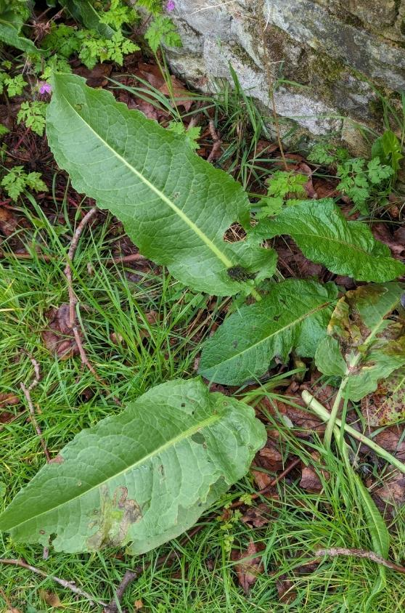
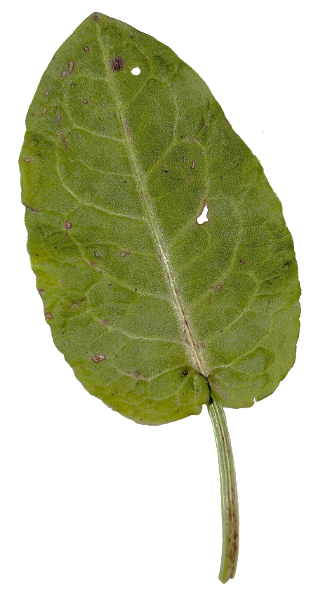
Dock
Thrives in high-nutrient and disturbed environments

Slide 12

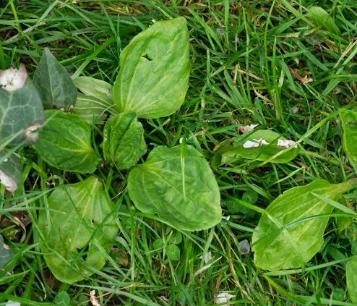
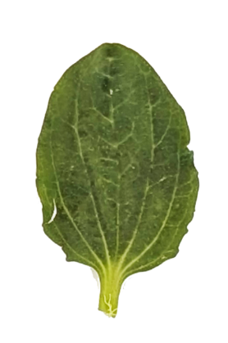
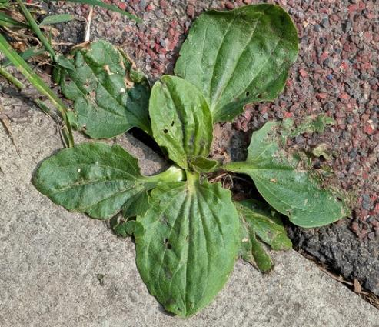
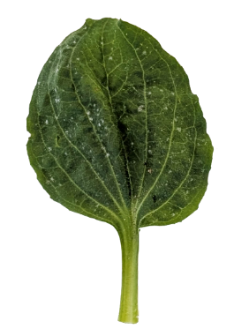
Greater plantain
Tolerant of trampled and disturbed environments

Slide 13
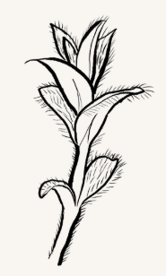
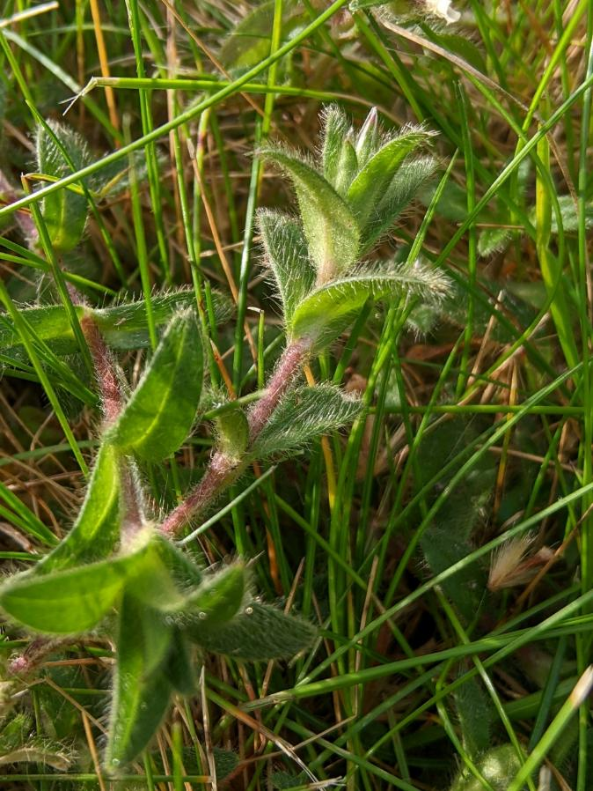
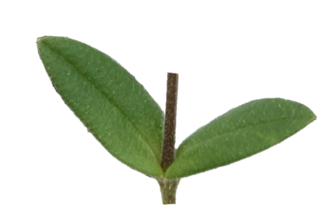
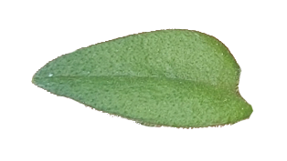
Common mouse-ear
Tolerant of high nutrients and mowing.

Slide 14
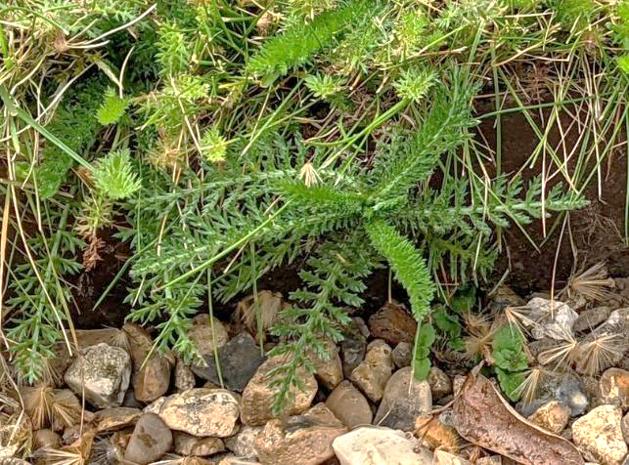
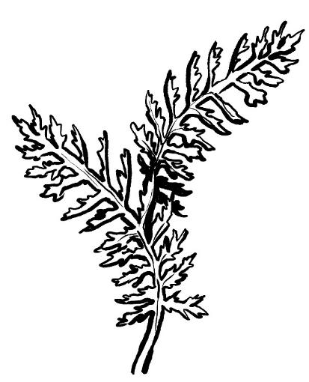
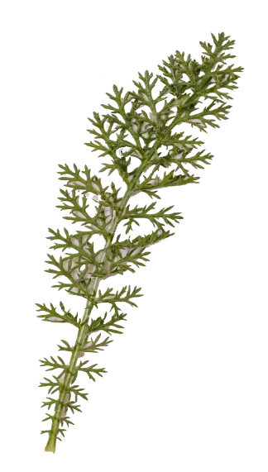
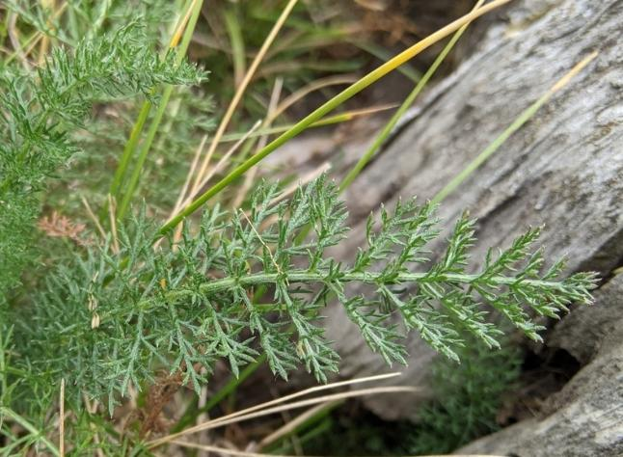
Yarrow
Tolerant of dry environments and some mowing.

Slide 15
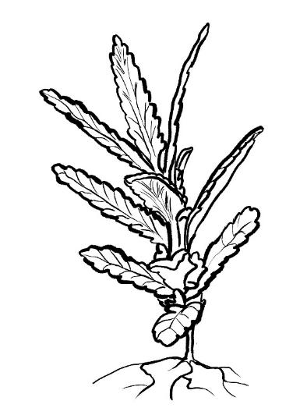
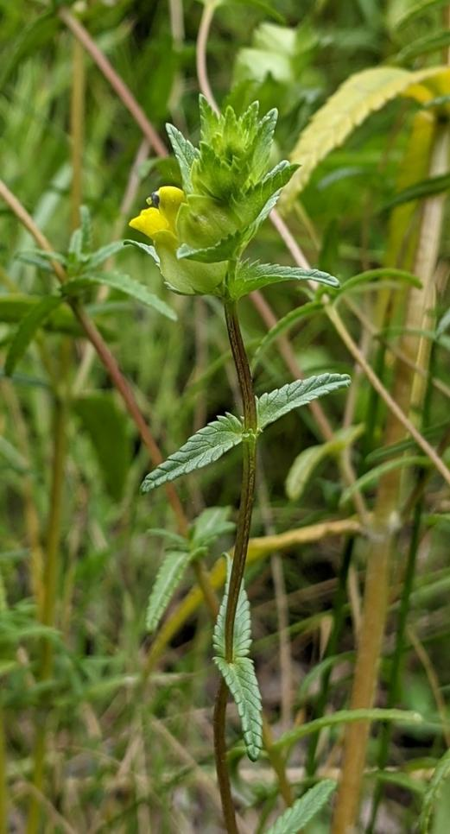
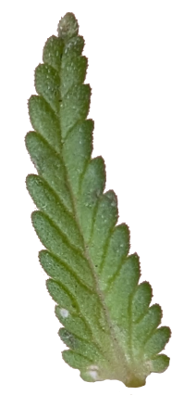
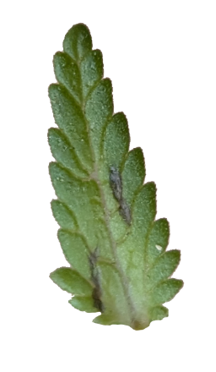
Yellow rattle
Tolerant of nutrient-poor soils.
Not tolerant of trampling or mowing.
Yellow rattle is a parasite of grasses. Its roots attach to those of grasses and draw nutrients from them. This slows their growth and allows other plants to compete for space, water and nutrients.
People often grow yellow rattle in grassy areas to help convert them into meadows.

Slide 16
Using indicators to characterise habitats

Slide 17
Environmental quality indicators
Indicator plant | Cutting tolerance | Compaction tolerance | Soil pH | Nutrient levels
Common Mouse-ear |  |  | Neutral | Low
Greater Plantain | Tolerant | Tolerant |  | Low
Dock |  |  |  | High
Daisy | Tolerant | Tolerant | Neutral
Dandelion | Tolerant | Tolerant |  | High
Clovers | Tolerant
Yarrow | Tolerant |  | Neutral/ acid
Yellow-rattle | Not tolerant |  | Neutral
While the indicator plants cannot tell us about the exact grassland type, they do provide useful information about the qualities or abiotic factors in the area.
Finding high concentrations of certain species can be indications about soil characteristics such as pH or compaction.

Slide 18
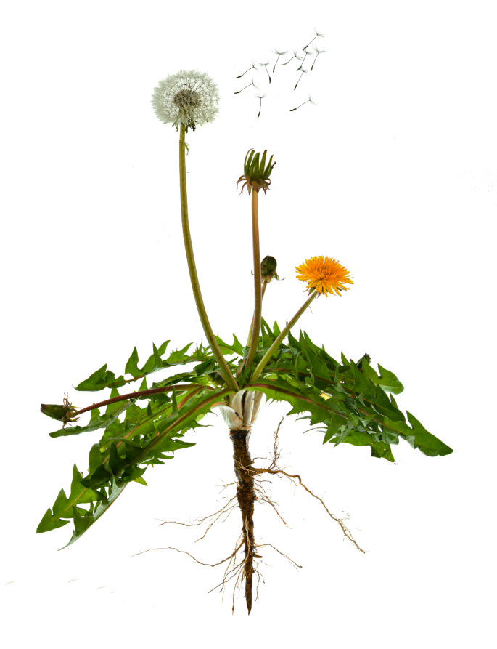
Key vocabulary
Some of the nutrients plants need to grow
Nutrients
Any substance that living things need to survive and grow. Nutrient concentrations have big impacts on an ecosystem.*
Examples
Nitrogen is a nutrient plants and other living things need to grow, make proteins and repair damage.
Sugars are nutrients that most living things need for energy.
Carbon dioxide
Nitrogen
Phosphorous
Water
Potassium
Notes:
*Nutrients in too high a concentration in soil can affect plants’ uptake of water by osmosis and can lead to ‘scorching’ where the water is pulled from the leaves by high concentrations of fertilisers in the soil, causing leaves to become dry and crispy despite moisture in the soil.
Plants vary in their ability to utilise available nutrients. Fast-growing plants like grasses and algae can grow very quickly if they have access to sufficient nutrients. In these situations, they can out-compete slower-growing species for space, light or nutrients, killing those other species. In this way, nutrient enrichment of some environments can reduce biodiversity.
In aquatic environments, phosphorous and nitrogen compounds from fertilisers and manure washing into the water body can cause blooms of algae and lead to a process called eutrophication (ew-tri-FI-kay-tion). This is where algae grows so thick it blocks light from reaching other submerged plants, killing them. As the algae cells die, their decomposition takes oxygen out of the water, which kills off many animals in the water body.

Slide 19

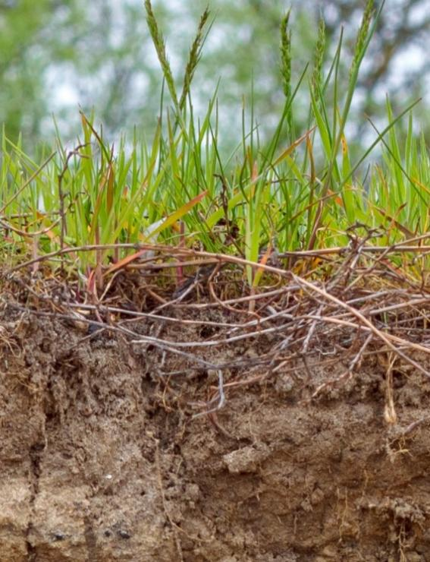
Grasslands
Grasses are the main plants in a grassland habitat.
If there are a lot of nutrients available in the soil, grasses can grow very quickly. Their roots can form tight mats that other plants have trouble pushing through.
This means grasses can outcompete many slower-growing plants for water, nutrients and space.
Grass
Imagine being another plant trying to grow through these grass roots!

Slide 20
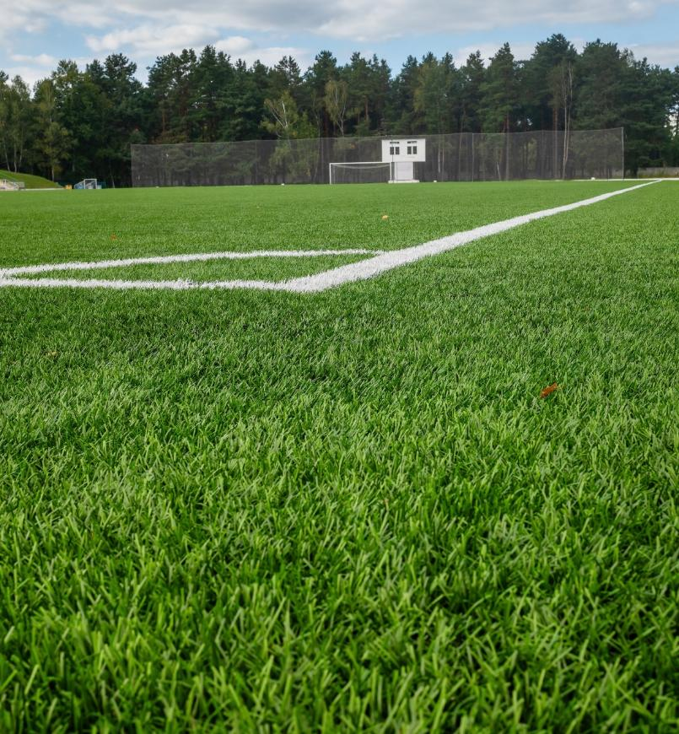
Lawns
How many types of grass can you spot in this sports field?
Human-made grasslands that are highly managed and fertilised, such as football pitches and golf courses, might have as few as one or two grass species and very little other biodiversity.
Sometimes specific types of grass are grown on playing fields. People choose grasses that will grow in the way they need and be tough enough for the sport being played.

Slide 21
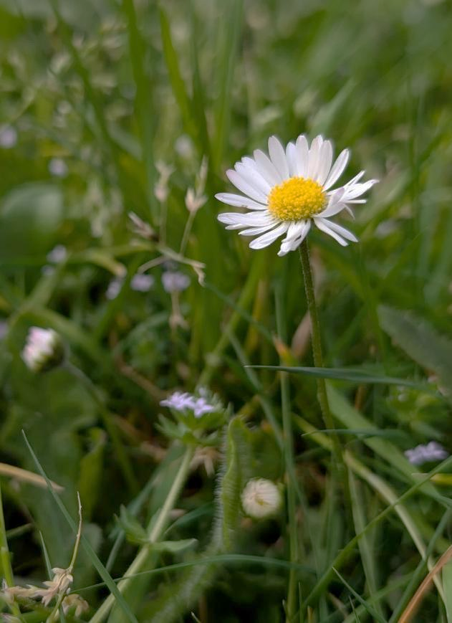

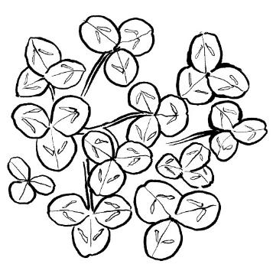

Grassland plants
Intensively mown and managed grasslands like lawns can still have some biodiversity.
The plants below can grow and compete with grasses under a wider range of conditions. They are common in many grasslands, both meadows and human-made lawns.
Yarrow
Clovers and their relatives
Common daisy

Slide 22
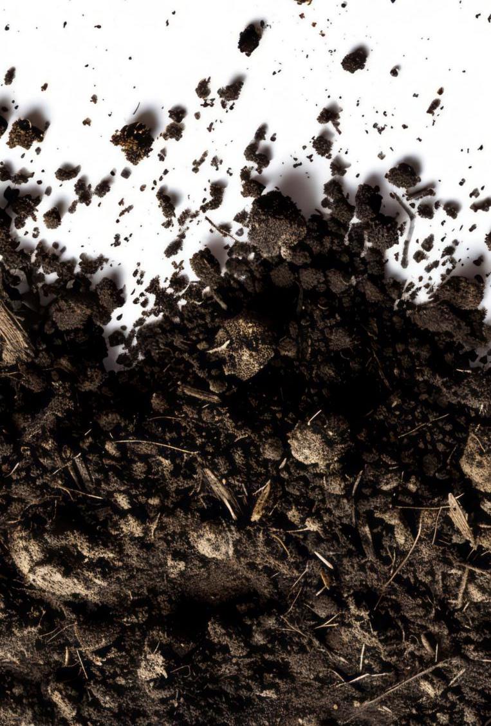
Key vocabulary
Less compacted soil particles
Compaction
Squashing together soil particles.
This reduces the rate at which air and water can move through the soil.
More compacted soil particles

Slide 23
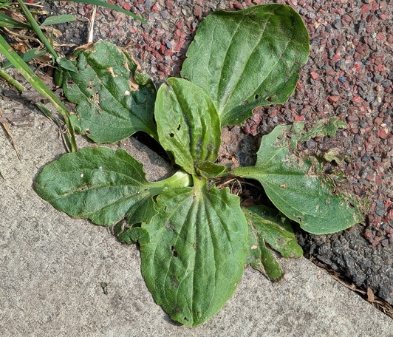
Plant roots take in water and nutrients for the plant. Plant roots also need oxygen.
Compaction affects how water and air move through the soil.
Some plants have roots that are more tolerant of how much water and oxygen they have around. So compaction affects how well these plants can grow.
Greater plantain can live in very compacted soil. This greater plantain plant is growing in a pavement!

Slide 24
Types of grassland

Slide 25
Nature Park grassland categories
The indicators that were selected needed to be common and easy to recognise. These requirements mean the plants can’t be used to exactly identify the grassland type.
The Nature Park team have changed amenity grassland to lawns and playing fields. Other grassland types are grouped together as meadows.
National Plant Monitoring Scheme habitats
Indicator species | Amenity grassland | Neutral pasture and meadow | Neutral damp grassland | Dry acid grassland
Common mouse-ear
Greater plantain
Broad-leaved dock |  | - | -
Daisy
Dandelion
Clovers
Yarrow
Yellow-rattle
-
indicator of this habitat
indicates the habitat is not in good health
For more information about natural grassland habitats, see the Grassland ecosystems resource.

Slide 26


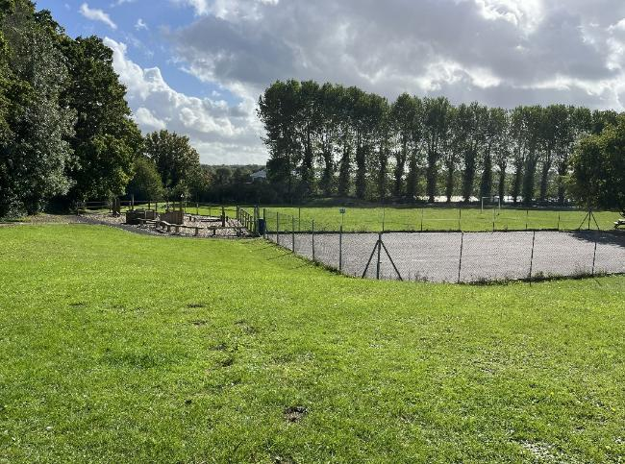

Playing fields or lawns
Nature Park habitat type
plants usually under 10cm tall
fewer than eight leaf types in a 1sqm area
Indicators that soil may have high nutrient levels.
Dandelion
Broad-leaved dock
Indicator that soil may be compacted.
Greater plantain
Added fertilisers and compaction are both human impacts on an area that are associated with lower overall biodiversity.

Slide 27
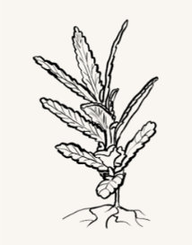
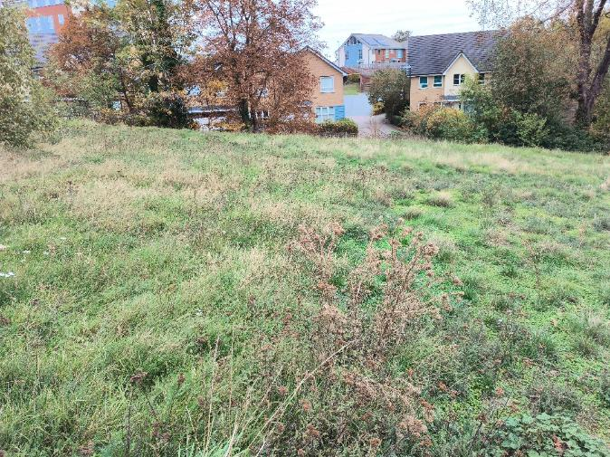

Meadow
Nature Park habitat type
plants usually more than 10cm tall
eight or more leaf types in a 1sqm area
Often seeded in grassy areas to slow the growth of grasses and allow other plants to compete.
Yellow rattle
An indicator that the area is probably less disturbed or trampled.
Common mouse-ear
Less vigorous grass growth and less disturbance by humans are both associated with higher overall biodiversity.

Slide 28
Comparisons of related or similar species
Suggested for KS4

Slide 29
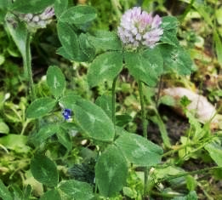
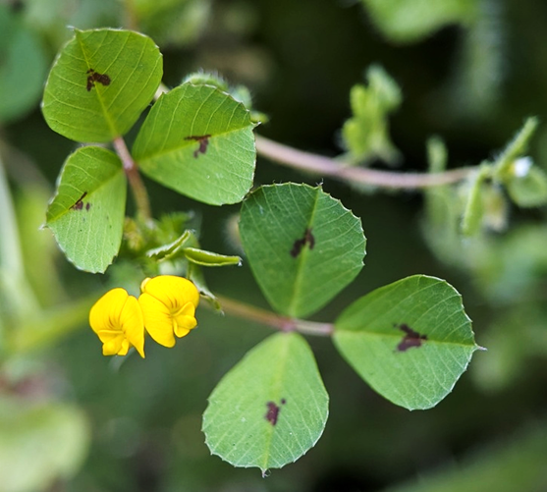
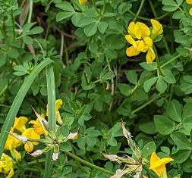
The Grassland Plant Survey uses common plants and groups together related species to maximise the chances of finding at least one of the indicators in a quadrat.
Recognising species related to the ones in the survey can provide more detailed information. The following slides show relatives of the indicator species in the survey and what they can indicate about your site.
Use identification charts, books, or iNaturalist to identify the plant species you find in your quadrats.
Clovers and their relatives
Red clover
Stopped medic
Bird’s-foot trefoil
There are more than 30 species in the UK that are clovers or clover-like. Some of them are less tolerant of soil conditions and are associated with more specific habitats.

Slide 30
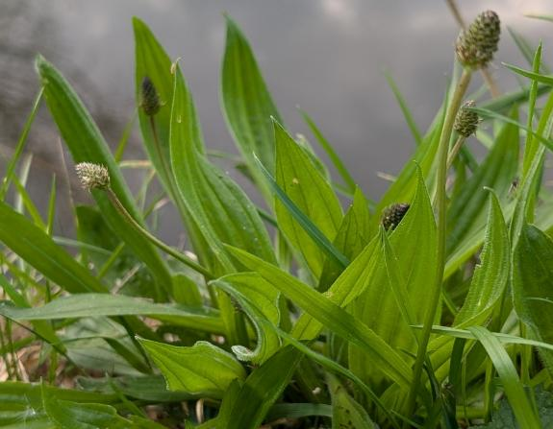
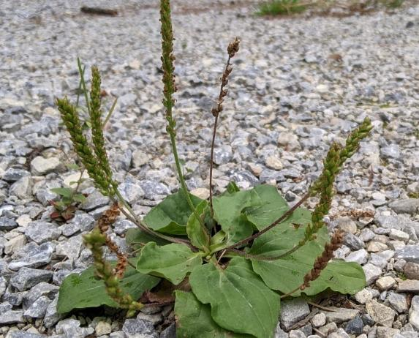

Plantains
Ribwort plantain
generalist
Greater plantain
compacted soils
Hoary plantain
free-draining soils
Notes:
Free-draining soils allow water to drain through relatively quickly. They often contain more sand and less clay, and less organic matter.

Slide 31



Docks
Broad-leaved dock
generalist
nutrient rich soils
Wood dock
shaded areas
Water dock
wet areas

Slide 32


Mouse-ear chickweeds
Common mouse-ear
generalist
Sticky mouse-ear
drier conditions
free-draining soils
Notes:
Free-draining soils allow water to drain through relatively quickly. They often contain more sand and less clay, and less organic matter.

Slide 33



Clovers and their relatives
Red clover
nutrient-rich soils
Spotted medic
acidic soil
Bird’s-foot trefoil
alkaline soil

Slide 34






Daisies
Oxeye daisy
less tolerant of mowing or grazing
Common daisy
more tolerant of mowing or grazing

Slide 35
Practice

Slide 36



What differences can you see between these grassland quadrats?
What might these differences tell us about each grassland?
1
2
3
Notes:
Learners can refer to the indicator species reference handout.
1. Some differences learners might spot:
The percentage of the area covered by clover decreases from quadrat 1 to 3.
The percentage of the area covered by greater plantain increases from quadrat 1 to 3
2. Differences indicated include:
More plantain indicates Grassland 3 is likely more trampled and more compacted than grassland 1.
Bare soil can indicate very high levels of foot traffic, making the soil very compacted and preventing many seedlings from surviving.

Slide 37
Use the indicator species tables and the Example Quadrats presentation to practice doing the survey and inferring the quality of the habitat using indicator species.
Get outside and find a few areas where you can do the Grassland Plant Survey. Then use the tables with your survey results to learn more about the qualities of the grasslands around your site.

